Slide 1

ECE 220 Computer Systems & Programming
Lecture 23 – Intro to C++ and Inheritance
Notes:
ECE Main Slide

Slide 2
C++ - Class & Encapsulation
Created in 1979 by Bjarne Stroustrup at Bell Labs, as an extension to C
It’s an object oriented language
OOP Concepts:
Encapsulation, Inheritance, Polymorphism, Abstraction
Class in C++ is similar to Struct in C, except it defines the data structure AND
control “who” can access that data
provide functions specific to the class
C
C++
2

Slide 3
Concepts Related to Class
An object is an instance of the class
shares the same functions with other objects of the same class
but each object has its own copy of the data
Constructors & Destructors
Constructor – a special member function that creates (initiates) a new object
Destructor – a special member function that deletes an object.
member functions (also called methods) - functions that are part of a class
Private vs. Public members
private members can only be accessed by member functions (private access is the default in a class)
public members can be accessed by anyone
3

Slide 4
Basic Input / Output
cin – standard input stream
cout – standard output stream
namespace –
“using namespace” directive tells compiler the subsequent code is using names in a specific namespace
Example:
#include <iostream>
using namespace std;
int main(){
char name[20];
cout << “Enter your name: ”;
cin >> name; //cin.getline(name, sizeof(name));
cout << “Your name is: ” << name << endl;
}
4
Notes:
by using namespace, we do not need to have std::cout or std::cin, just the identifier itself

Slide 5
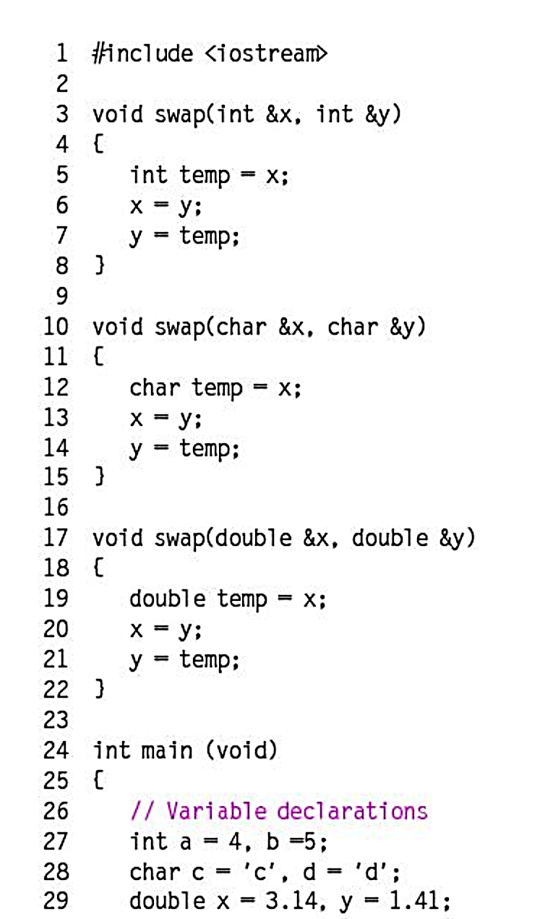
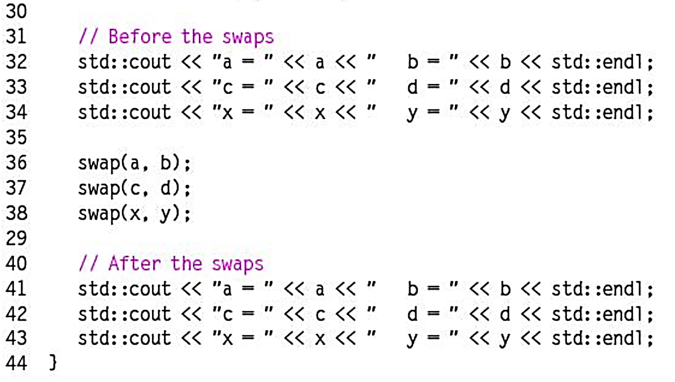
Namespaces
Input Output (<<, >>, combined with cout and cin respectively)
Pass by reference
Function overloading

Slide 6
Dynamic Memory Allocation
new – operator to allocate memory (similar to malloc in C)
delete – operator to deallocate memory (similar to free in C)
Example:
int *ptr;
ptr = new int;
delete ptr;
int *ptr;
ptr = new int[10];
delete [] ptr;
7

Slide 7
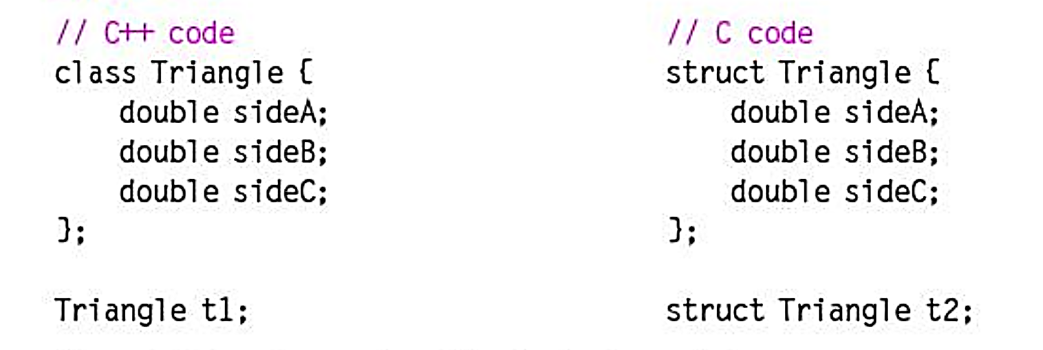
Classes

Slide 8
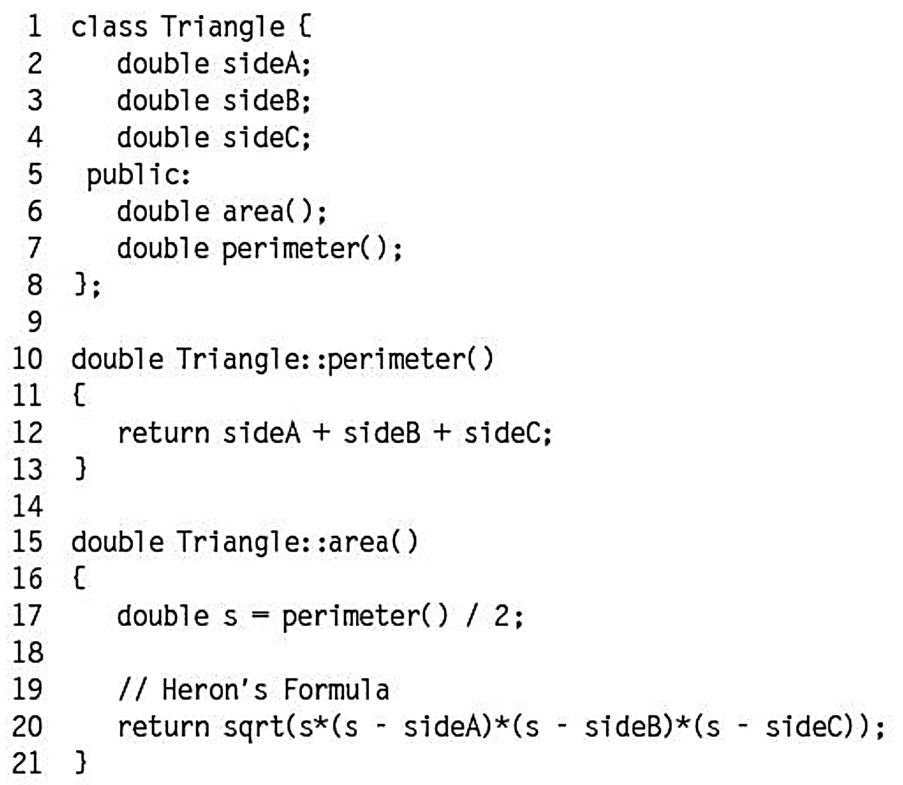
Methods

Slide 9
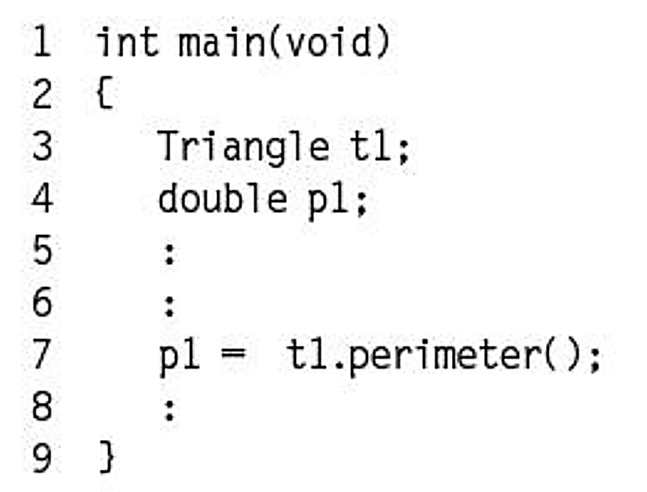
A Method call in C++

Slide 10
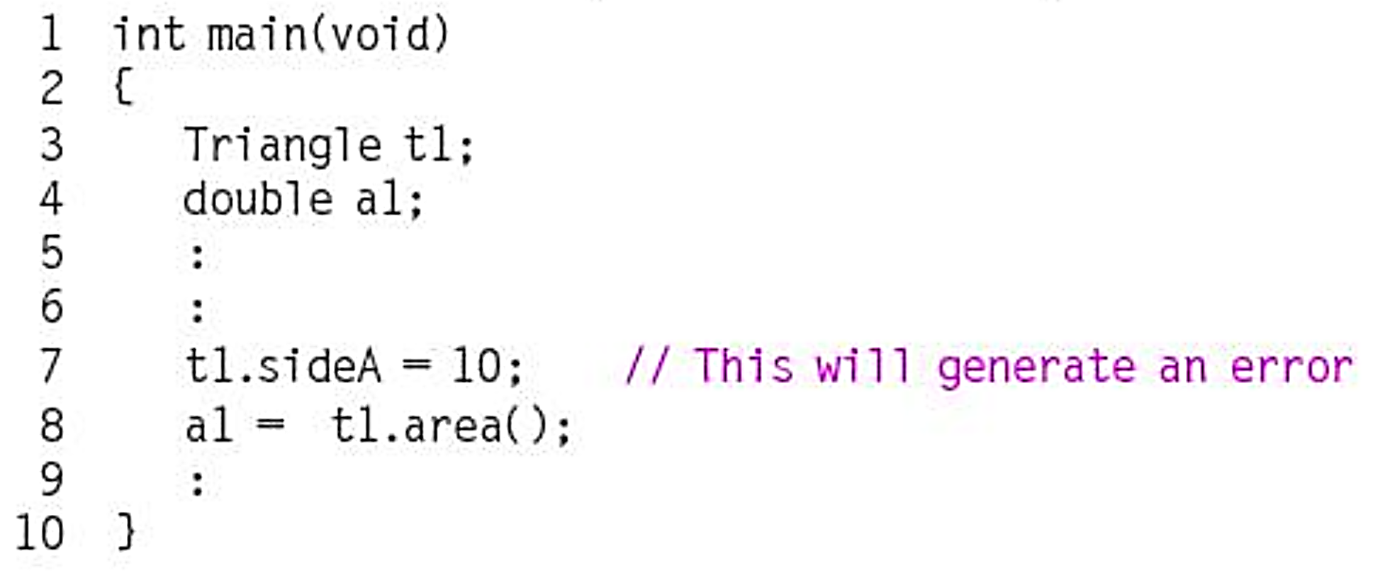
Access Specifiers for private member:
SideA, SideB and SideC

Slide 11
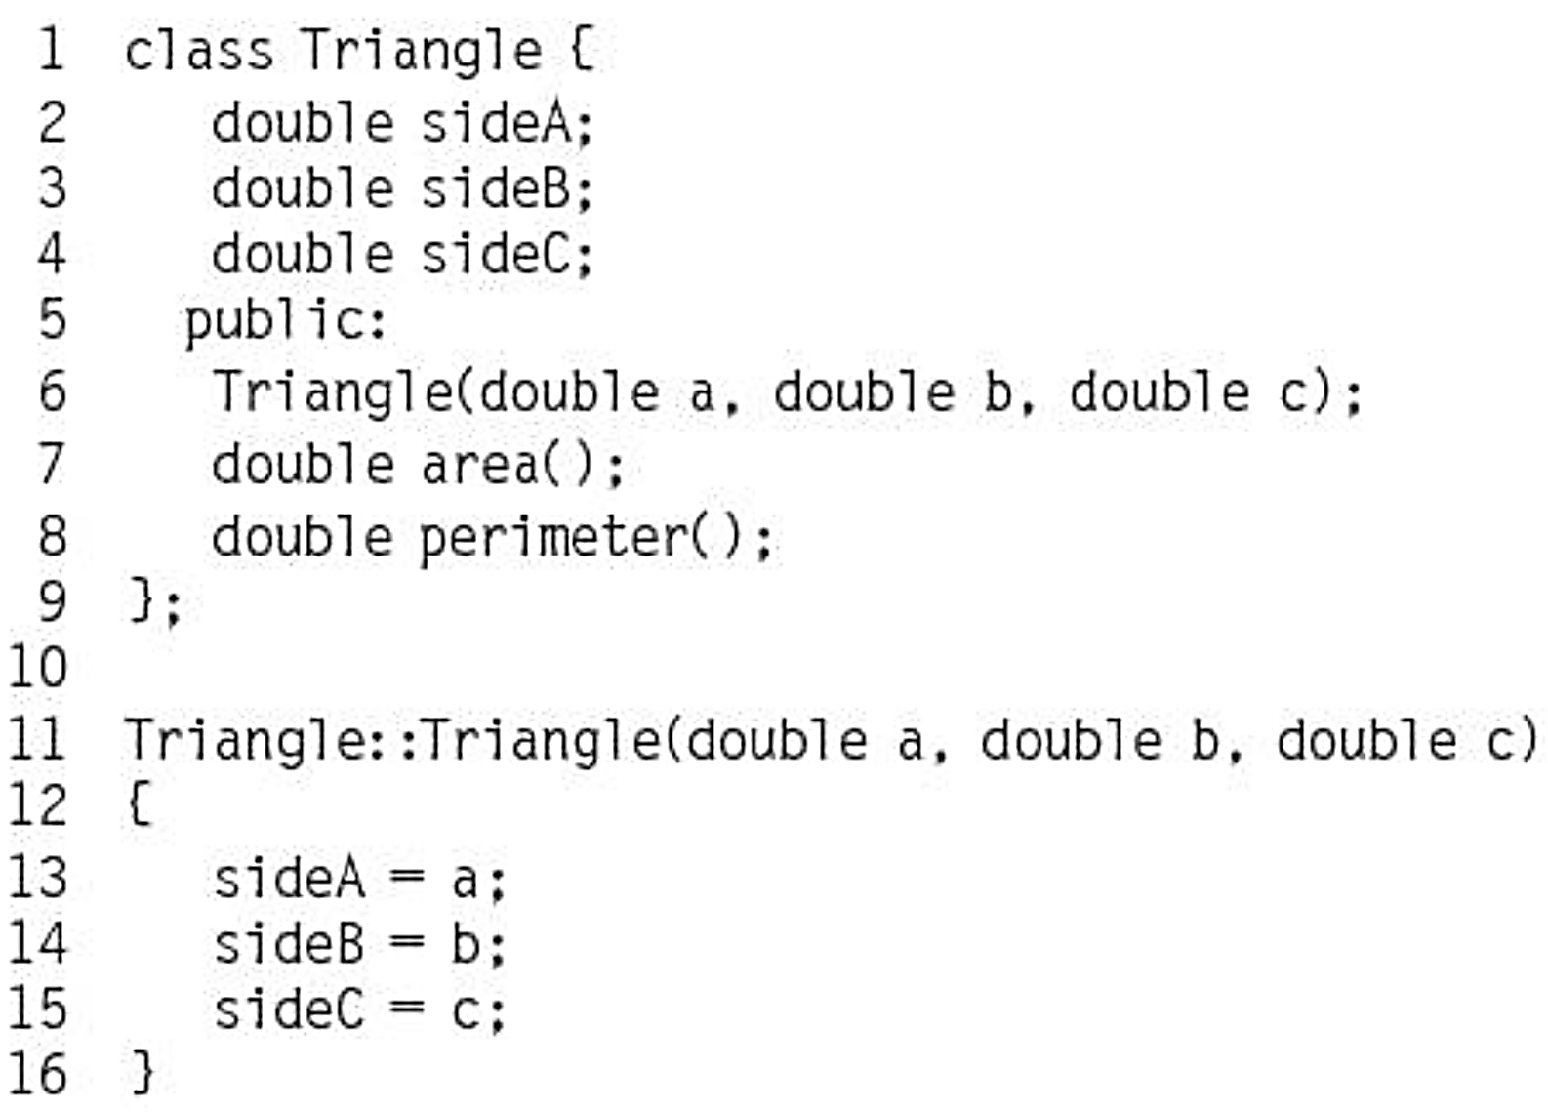
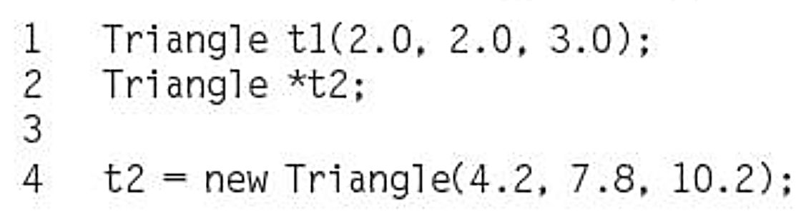
Constructor

Slide 12
Example: C vs. C++ for adding two vectors
Code is Posted on Github:
L23main.c
L23_main.cpp

Slide 13
Exercise – Write Constructors
class Rectangle(
int width, height;
public:
Rectangle();
Rectangle(int, int);
int area() {return width*height;}
};
Rectangle::Rectangle(){
//set both width and height to 1
}
Rectangle::Rectangle(int a, int b){
//set width to a and height to b
}
5

Slide 14
Exercise – Access Member in a Class
int main(){
Rectangle rect1(3,4);
Rectangle rect2;
//print rect1’s area
//print rect2’s area
return 0;
}
What is the area of rect1? How about rect2?
6

Slide 15
Exercise – Pointer to a Class
int main(){
Rectangle rect1(3,4);
Rectangle *r_ptr1 = &rect1;
//print rect1’s area through r_ptr1
Rectangle *r_ptr2, *r_ptr3;
r_ptr2 = new Rectangle(5,6);
//print area of rectangle pointed to by r_ptr2
r_ptr3 = new Rectangle[2]{Rectangle(),Rectangle(2,4)};
//print area of the 2 rectangles in the array
//deallocate memory
return 0;
}
8

Slide 16
Inheritance & Abstraction
C++ allows us to define a class based on an existing class, and the new class will inherit members of the existing class.
the existing class –
the new class –
A derived class inherits all base class member functions with the following exceptions:
Constructors, destructors and copy constructors of the base class.
Overloaded operators of the base class.
The friend functions of the base class.
6
Notes:
Although constructor and destructor of the base class are not inherited, the default constructor (i.e. constructor with no parameters) and the destructor of the base class are always called when a new object of a derived class is created or destroyed.

